Slide 1

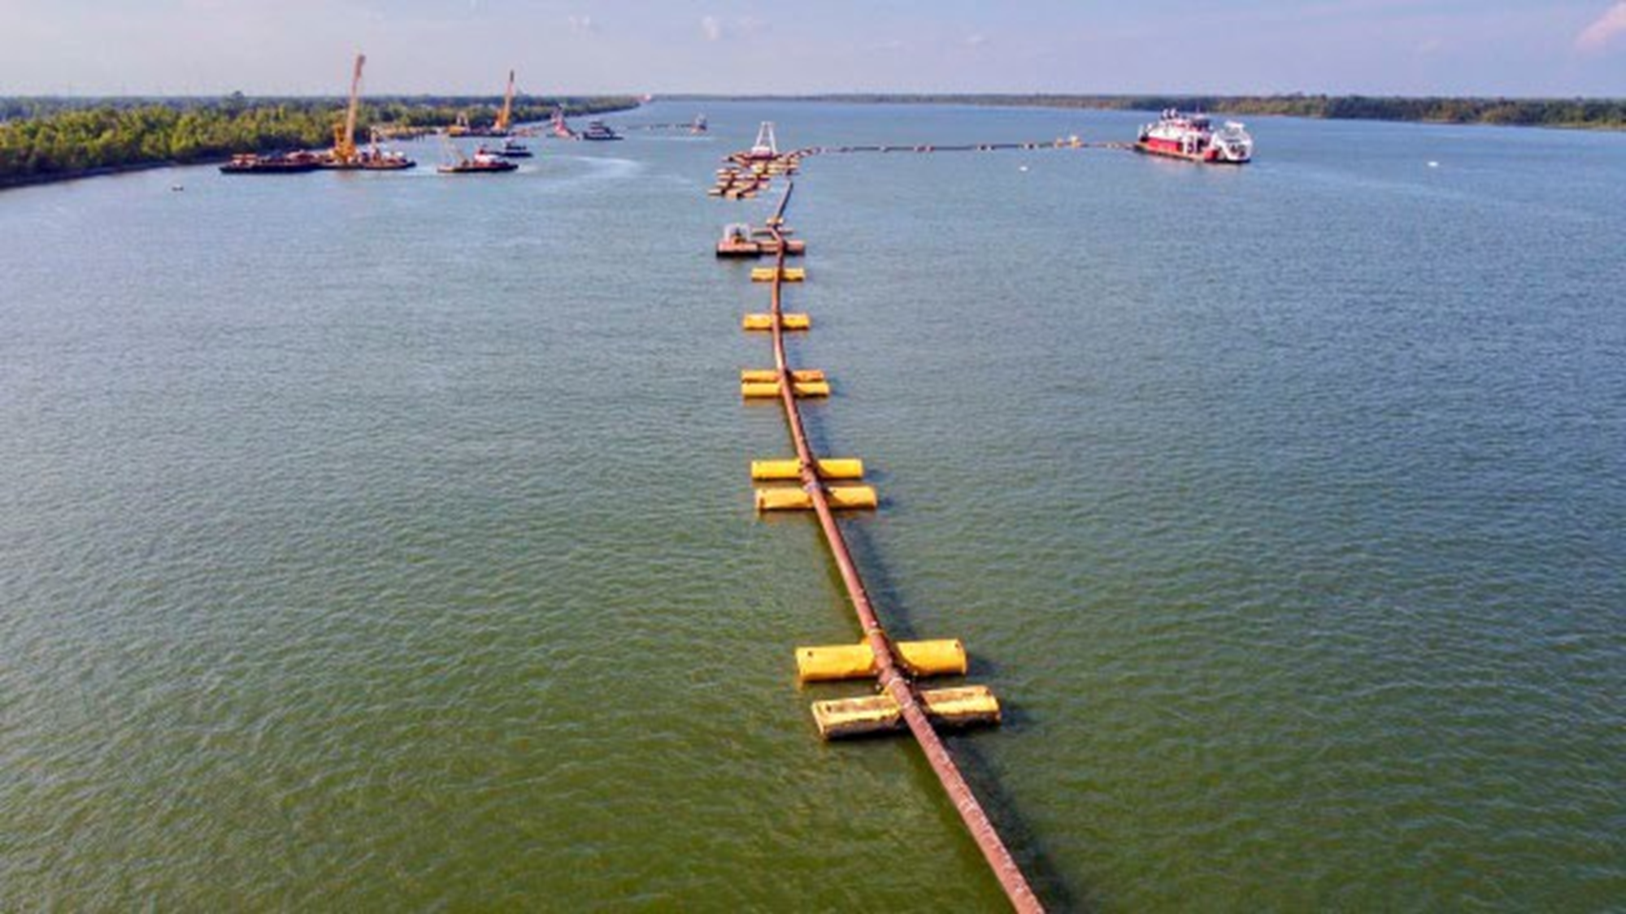


LEMC PLENARY Session
2023 LOUISIANA SALTWATER INTRUSION

Slide 2




PLENARY PANELIST
Patrick Harvey
John Rahaim
Joe Valiente
Collin Arnold
Plaquemines
St. Bernard
Jefferson
Orleans

Slide 3
PLENARY SESSION OUTLINE
Background & Objectives
Challenges and Opportunities
Stakeholders/Partners
Innovative Actions/Tasks
Timelines
Lessons Learned
Questions and Comments

Slide 4
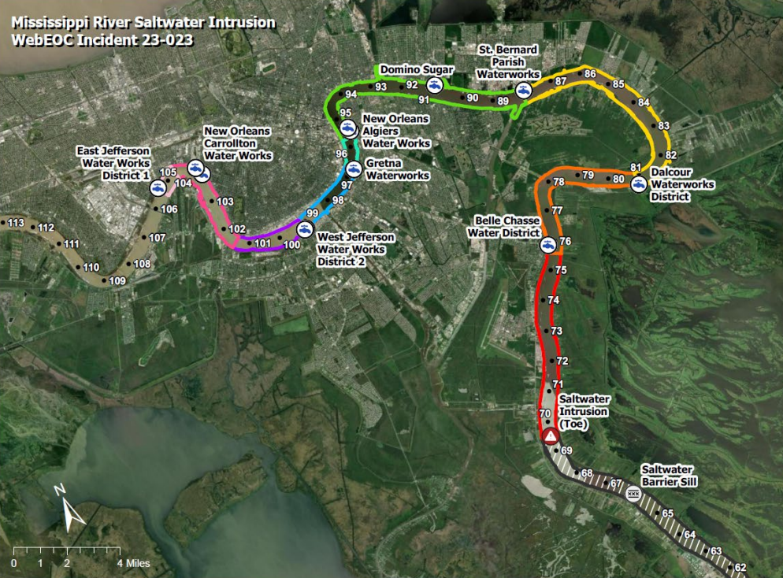



BACKGROUND & OBJECTIVES
Due to extended drought conditions in mid-2023, the freshwater flow rate of the Mississippi River decreased, which allowed an intrusion of saltwater of saltwater from the Gulf of Mexico to make its way toward lower parishes, but significantly impacting Plaquemines Parish.
Potential threats of saltwater:
  Decrease in community drinking water quality and increase in serious health risks, when ingested.
  Accelerated infrastructure corrosion by placing heavy metals and other toxins into the water system, especially with long-term exposure
Engage coordination and tactical planning to mitigate future impacts to communities
Collaborate with stakeholders and partners to support communication and address vulnerabilities
Align resources., research and technical support to devise solutions to prevent and protect from future impacts

Slide 5







CHALLENGES & OPPORTUNITIES
Data-Driven Planning, Engagement of Stakeholders and Partners, &
Solution-Focused Planning for both Short-Term and Long-Term Risk Reduction
Monitoring
Goals
Innovation
Equipment
Resources
Communication
Mitigation

Slide 6
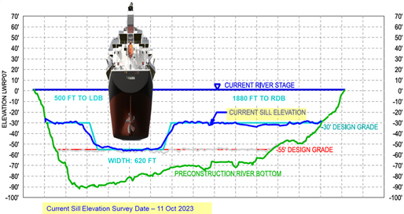
KEY MILESTONES
21 June
Plaquemines Declared State of Emergency
13 July
Louisiana requests USACE assistance
27 July
Saltwater sill constructed
20 September
Saltwater sill is overtopped
26 September
FEMA IMAT-1 deploys to Baton Rouge, LA
27 September
3600-EM-LA Federal EM Dec. for 4 parishes
01 October
Water barging operations begins
11 October
Dalcour ROPU arrives onsite
12 Octber
Sills augmentation completed

Slide 7
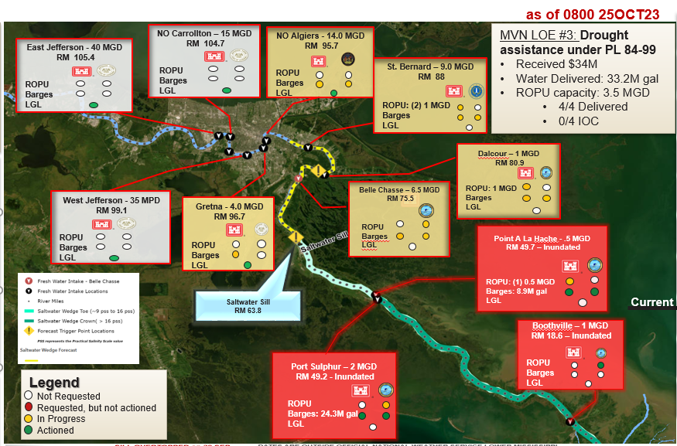

25 Oct 23
0800

Slide 8


COMMUNICATION CHAMPIONS
Television
Social network
Other Collaborations

Slide 9
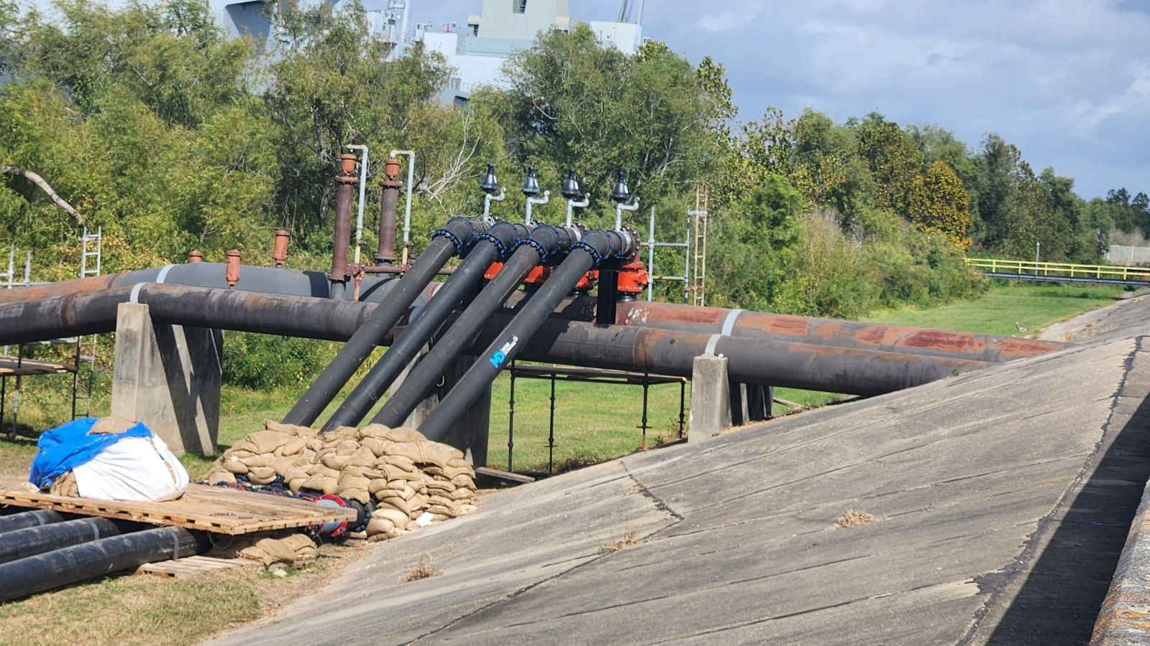
EFFECTIVE INNOVATIONS
  Partnership with USACE
  Collaboration with Water Systems and Treatment Centers
  Engaging Retailers and Health/Social Service Partners
  Critical Infrastructures Continuity Plans

Slide 10
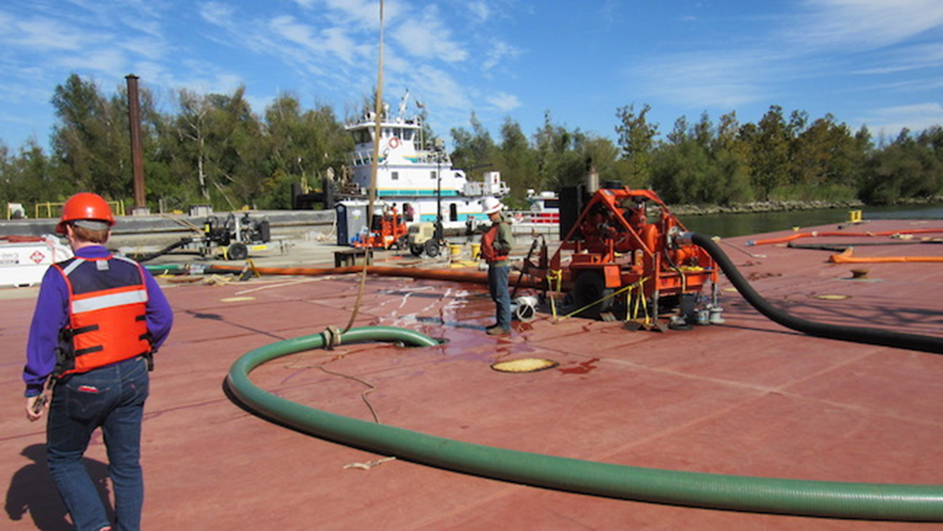
LESSONS LEARNED
  Proudest Accomplishments in managing this Incident
  Immediate Priorities to Reduce Risk or Advance Efforts for Future Impacts
  Improvements Identified, i.e., plans, organization, equipment, training, exercises or even with facilities

Slide 11
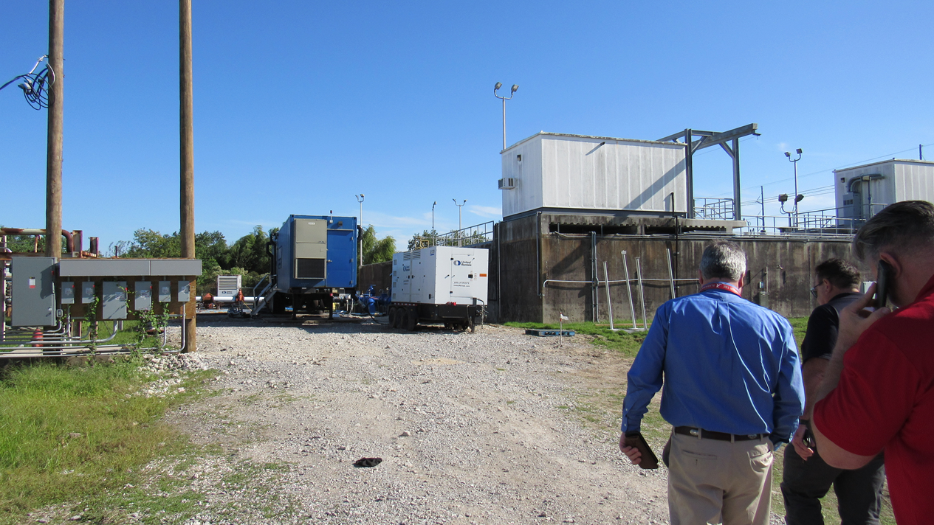
QUESTIONS/COMMENTS

